Slide 1



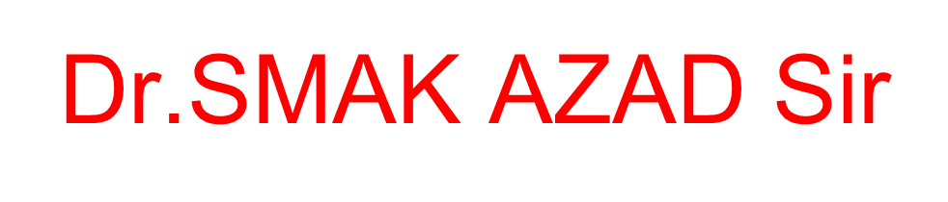


Slide 2
Movie Recommendation System Using ML
Capstone Review- Ⅲ
Under Guidance of Dr.Abdul Kalam Azad Sir
BOLISETTY SURYA PRAKASH
NAGA SAI SASI KIRAN KAKARPARTHI
SOMU CHANDRA KIRAN REDDY

Slide 3
Outline
Motivation & Objectives Met
Originality
Novelty
Methodology
Standard tools
Architecture
Results & Discussions
Timeline

Slide 4
Motivation & Objectives Met
The goal of the project is to recommend a movie to the user. Providing related content out of relevant and irrelevant collection of items to users.
Enhancing the user Experience
Improving scalability
Accuracy of Recommendation system
Providing quality and relevant movie
Objectives

Slide 5
Objectives Met
We achieved potential objectives that are met with our project
Used a content-based recommendation system to recommend movies based on their attributes or characteristics
Used natural language processing techniques to process and analyze the movie metadata
Used machine learning techniques to compute the similarity between movies
Recommend the top 5 most similar movies to the selected movie
Display the titles and plot summaries of the recommended movies
Provided a user-friendly interface for the recommendation system
Used The Movie DB API to fetch poster images for the recommended movies
Used Streamlit to build an interactive, web-based interface for the app

Slide 6
Introduction
A recommendation system or recommendation engine is a model used for information filtering where it tries to predict the preferences of a user and provide suggests based on these preferences.
These systems have become increasingly popular nowadays and are widely used today in areas such as movies, music, books, videos, clothing, restaurants, food, places and other utilities. These systems collect information about a user's preferences and then use this information to improve their suggestions in the future.
Movies are a part and parcel of life. There are different types of movies like some for entertainment, some for educational purposes, some are animated movies for children, and some are horror movies or action films.
Movies can be easily differentiated through their genres like comedy, thriller, animation, action etc. Other way to distinguish among movies can be either by releasing year, language, director etc.

Slide 7
Originality
Factors:
The originality of a movie recommendation system using machine learning (ML) will depend on a number of factors, including the data that is used to train the system and the specific techniques and approaches that are used to build the system.
One way to increase the originality of a movie recommendation system is to use a diverse and comprehensive dataset that includes a wide variety of movies and user preferences. This can help the system to recommend a wider range of movies to users and avoid recommending the same types of movies over and over.
In addition, using innovative techniques and approaches to build the system can also increase its originality. For example, using advanced ML techniques like deep learning or incorporating additional data sources, such as social media data, can help the system to make more personalized and original recommendations to users.
Overall, the originality of a movie recommendation system using ML will depend on the efforts put into creating a diverse and comprehensive dataset and using innovative techniques to build the system

Slide 8
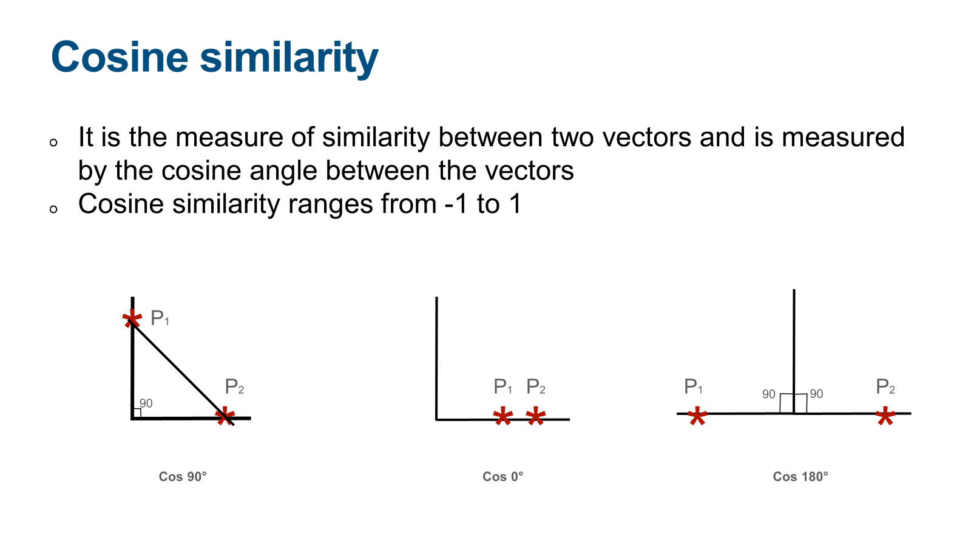
Cosine similarity

Slide 9
Cosine similarity is a measure of similarity between two vectors that is often used in recommendation systems and natural language processing tasks. Here are a few key points about how cosine similarity might be used in a movie recommendation system using machine learning with content filtering:
Vector representation of movies: In order to use cosine similarity, the movies being recommended must be represented as vectors of features or characteristics. These vectors could include features such as the genre, cast, plot summary, or ratings of the movies.
Calculating similarity: To calculate the cosine similarity between two movies, the dot product of the two movie vectors is divided by the product of their magnitudes. This results in a similarity score between 0 and 1, with higher values indicating greater similarity.
Recommendation generation: The cosine similarity scores between a given movie and all other movies in the dataset can be used to generate recommendations for the user. The movies with the highest similarity scores can be ranked and presented to the user as recommendations.
Content filtering: Cosine similarity can also potentially be used to filter out movies that contain inappropriate or offensive content. For example, the movie vectors could include a feature indicating the content rating of the movie, and the recommendation system could be configured to exclude movies with certain content ratings.
Overall, cosine similarity is a useful tool for calculating the similarity between movies in a recommendation system and can be used in combination with other techniques to generate personalized recommendations for users.

Slide 10
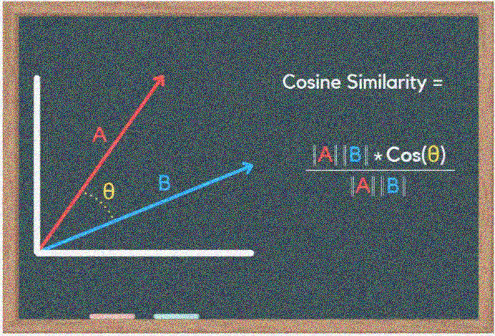
Using cosine similarity as a measure of similarity in a movie recommendation system using machine learning with content filtering is a common approach, and on its own may not necessarily contribute significantly to the originality of the project. However, there are other factors that could potentially contribute to the originality of your project, such as the specific data sources and features used as input, the evaluation metrics and results achieved, and any novel or innovative machine learning approaches or techniques that you have employed.

Slide 11
Novelty
We are extreamily code is implementing a basic movie recommendation system using a content filtering approach. Content filtering is a method of recommending items to users based on the preferences of other users who have similar tastes.
Some key points about this code are:
1. It uses a pre-computed similarity matrix to determine the similarity between movies. This matrix is likely based on user ratings or some other measure of movie similarity.
2. It fetches poster images for the recommended movies from The Movie DB API using movie IDs. This adds an visual element to the recommendations and makes them more appealing to the user.
3. It uses the Streamlit library to build a user interface for the recommendation system. Streamlit is a framework for building interactive, web-based apps in Python. It allows the developer to create a simple interface for the app using a combination of simple functions and Python code.
4. It includes a loading spinner and accompanying messages to give the impression that the app is working on generating the recommendations. This can improve the user experience by letting the user know that the app is still running and the recommendations are on their way.
Overall, our code appears to be a well-implemented example of a movie recommendation system using content filtering. It includes several features that make it more user-friendly and visually appealing.

Slide 12
Novelty
Here are a we are mentioned few potential ways in which these codes could be unique or innovative:
Content-based recommendation system: The second code appears to be implementing a content-based recommendation system, which generates recommendations based on the attributes or characteristics of the items themselves, rather than the preferences of other users. The specific approach taken to implement the content-based recommendation system in this code may be unique or innovative. For example, the way in which movie metadata is used to determine the similarity between movies or the specific features that are used to represent the movies could be novel.
Use of natural language processing techniques: The second code uses the Porter stemmer to stem the words in the 'tags' column, which is a common natural language processing technique. The specific way in which the Porter stemmer is used in this code may be unique or innovative.
Use of machine learning techniques: The second code uses the TfidfVectorizer from the scikit-learn library and the cosine_similarity function to compute the similarity between movies. These are common machine learning techniques that are often used in recommendation systems. However, the specific way in which these techniques are applied in this code may be unique or innovative when comparing with other recimmendations.

Slide 13

Novelty(Stremlit)
The use of The Movie DB API: Fetching poster images for the recommended movies using an API can add a visual element to the recommendations and make them more appealing to the user. It is possible that other movie recommendation websites may not use an API in this way or may use a different API.
The user interface built with Streamlit: Using Streamlit to build the user interface for the app may be a unique approach compared to other movie recommendation websites. Other websites may use different frameworks or technologies to build their interfaces.

Slide 14
Methodology
The approach proposed an integrative method by merging data preprocessing and vectorisation techniques to construct a movie recommendation system.
The proposed movie recommendation system gives finer similarity metrics and quality then the existing Movie recommendation system but the computation time which is less than the existing recommendation system.
This problem can be fixed by taking the clustered data points as an input dataset
The proposed approach is for improving the scalability and quality of the movie recommendation system .
We use a content based approach , by unifying Content-Based Filtering through which it can be clustered through the attributes of the input, so that the recommendations can be profited from each other.

Slide 15
Methodology
1.collecting the data sets: Collecting all the required data set from Kaggle web site.in this project we require movie.csv,ratings.csv,users.csv.
2.Data Analysis: make sure that that the collected data sets are correct and analysing the data in the csv files. i.e. checking whether all the column Fields are present in the data sets.
3.Algorithms: In our project we have only two algorithms one is cosine similarity and other is single valued decomposition are used to build the machine learning recommendation model.
4.Training and Testing the model: once the implementation of algorithm is completed . we have to train the model to get the result. We have tested it several times the model is recommend different set of movies to different users.
5.Improvements in the project: In the later stage we can implement different algorithms and methods for better recommendation.

Slide 16
Data Collection
Movie Data set: https://www.kaggle.com/datasets/tmdb/tmdb-movie-metadata?select=tmdb_5000_movies.csv
Import Packages like numpy, pandas, etc
Create a data frame for the Data sets
Analyse the data
Get the first row of data set to review about columns present in the data set (dataset_name.head(1))
Merge two data frames i.e movies and credits
Merging of data frames is done based on title of the movie.

Slide 17
Data Pre-Processing
Arrange data as per requirement such as removing unwanted columns from data frame
We use genres, id, keywords, titile, overview, cast and crew
Import Ast and use ast.literal_eval( )
Using ast we simplify genres and keywords in a alphanumeric order
Removing white spaces between strings
Using Porter Stemmer removing morphological and inflexional endings

Slide 18
The code we provided is a Python script that builds a movie recommendation system using machine learning with content filtering. The script performs a number of operations to preprocess and prepare the data for use in the recommendation system, including:
Importing and merging two datasets: The script imports two datasets, tmdb_5000_movies.csv and tmdb_5000_credits.csv.
And merges them on the ‘title’ column to create a single dataset of movies cleaning and preprocessing the data: The script removes null values from the dataset, and applies a series of functions to convert various columns into lists of strings. These functions use the ‘ast’ library to parse strings containing lists of dictionaries, and extract specific values from the dictionaries.
Creating a tags column: The script concatenates the processed overview, genres, keywords, cast, and crew columns into a single tags column, which will be used as input to the recommendation system.
Stemming and tokenizing the text data: The script uses the nltk library to stem and tokenize the text data in the overview, genres, keywords, cast, and crew columns. This involves removing common morphological and inflexional endings from the words, and splitting the text into individual tokens.
Overall, the script performs a number of operations to preprocess and prepare the data for use in a movie recommendation system using machine learning with content filtering.

Slide 19
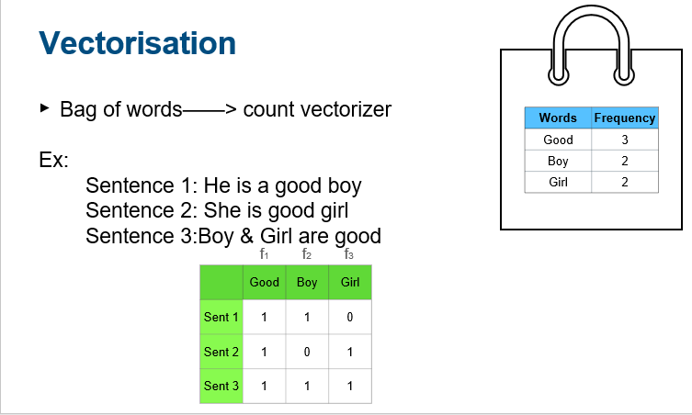

Slide 20
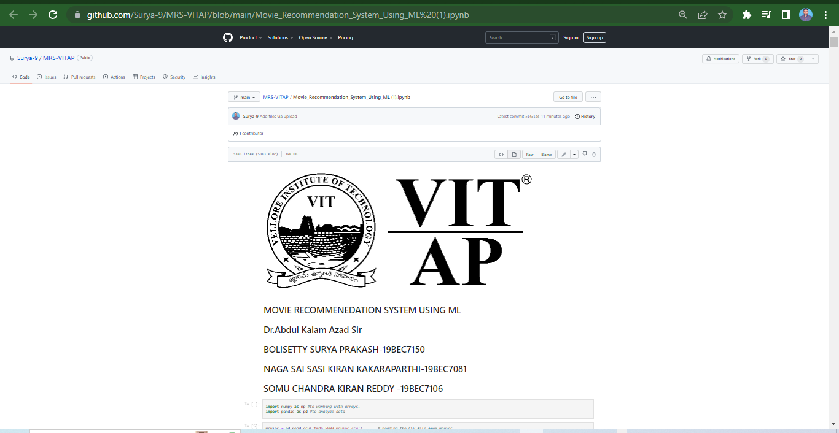
Code: (Back-End: Python)
Here I am attaching direct Python IPYNYB file URL by clicking we can get our source code. This screenshot is the URL interface
👉MRS_VITAP👈

Slide 21
Results:
The main principle of behind results are :
It looks like we have defined a function called recommend that takes in a movie title and returns a list of recommended movies. The function seems to be using a dataframe new_df that contains information about movies, and an array similarity that represents the similarity between movies.
The function first finds the index of the input movie in the dataframe using new_df[new_df['title'] == movie].index[0]. Then, it retrieves the row of similarity scores for the input movie from the similarity array using this index.
Next, the function sorts the list of movies by their similarity scores to the input movie in descending order, and returns the top five movies from this list.

Slide 22
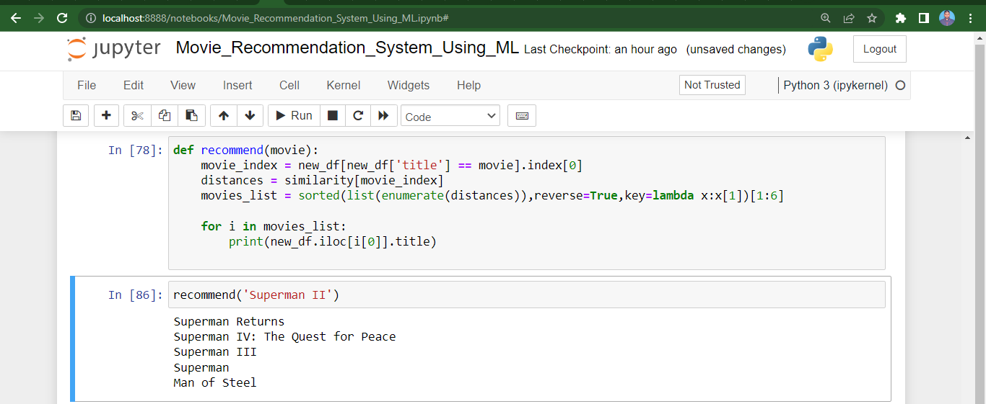
Results: Screenshots (Superman – II)

Slide 23
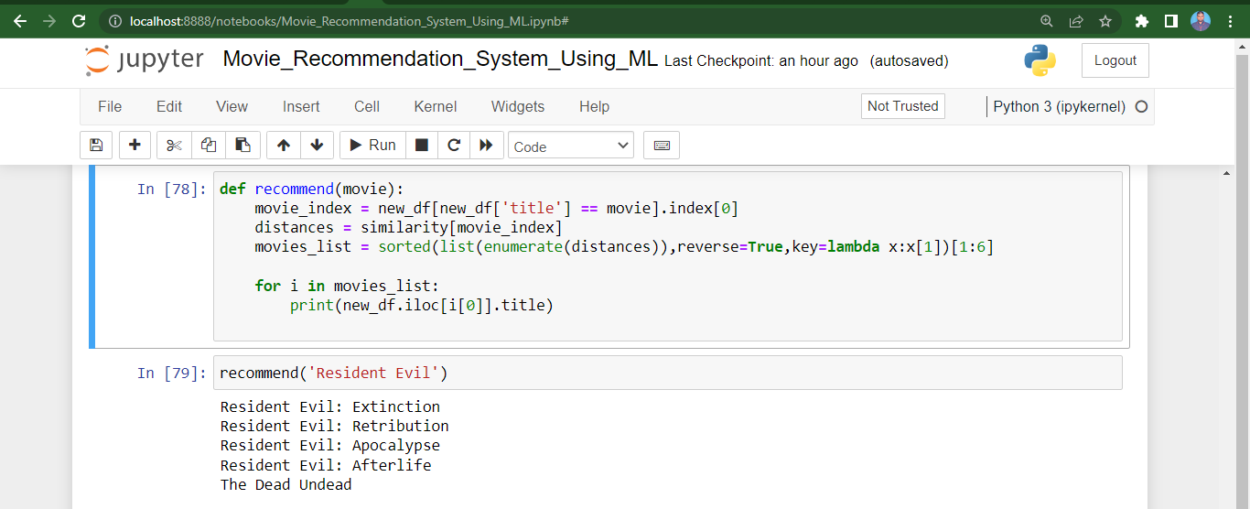
Resident Evil

Slide 24
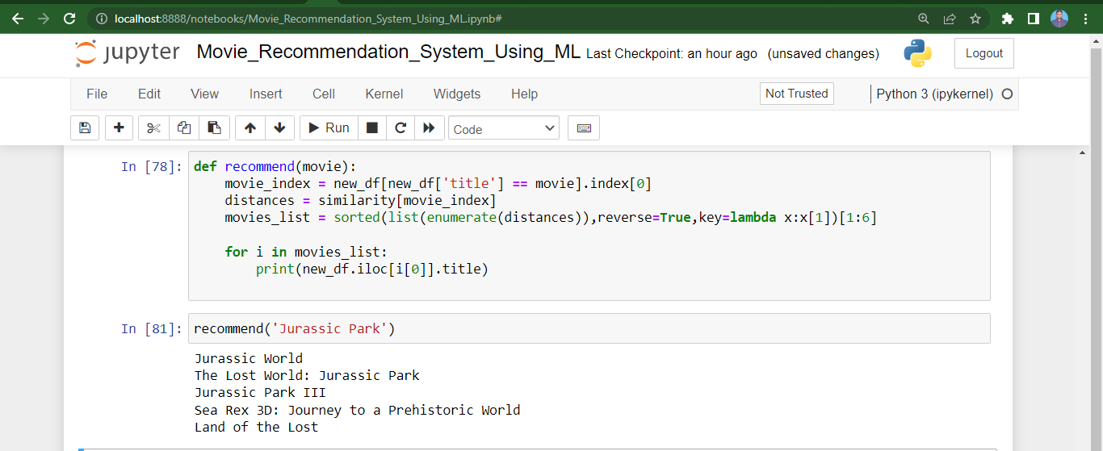
Jurassic Park

Slide 25
Front-End(Streamlit)
Streamlit can be used as a frontend library for building interactive, web-based applications in Python.
It provides a range of functions and components that can be used to build the user interface of the app, including functions for displaying text, images, tables, charts, and more.
The here we provided uses Streamlit to build the user interface for a movie recommendation system.
It includes a selectbox for the user to select a movie and a button for the user to initiate the recommendation process.
It also includes functions to display the recommended movies and their poster images.
Streamlit allows the developer to build the interface using a combination of simple functions and Python code, making it relatively easy to create interactive, web-based apps in Python

Slide 26
Here are the main steps involved in the implementation of the movie recommendation system in the frontend, using a content filtering approach:
1. Import the required libraries and functions: The code imports the necessary libraries and functions, including Streamlit, pickle, pandas, and requests.
2. Load the movie data and similarity matrix: The code uses pickle to load the movie data and similarity matrix from two pickle files: 'movie_dict.pkl' and 'similarity.pkl'. The movie data is stored in a pandas dataframe, while the similarity matrix is stored as a NumPy array.
3. Define the user interface: The code uses Streamlit functions to define the user interface for the recommendation system. It includes a selectbox for the user to select a movie, a button to initiate the recommendation process, and functions to display the recommended movies and their poster images.
4. Define the recommendation function: The code defines the recommend function, which takes a movie title as input and returns a list of recommended movies and their poster images. The function first finds the index of the selected movie in the movie data dataframe, then retrieves the row from the similarity matrix that corresponds to that index. It sorts this row in descending order and selects the top 5 most similar movies (excluding the selected movie itself). It then retrieves the movie titles and poster images for these movies and returns them.

Slide 27
Fetch poster images from The Movie DB API: The code defines the fetch_poster function, which takes a movie ID as input and returns the poster image for that movie. It uses the requests library to send a GET request to The Movie DB API with the movie ID and retrieves the poster path from the response. It then constructs the full URL for the poster image and returns it.
Display the recommended movies and their poster images: The code uses Streamlit functions to display the recommended movies and their poster images. It divides the user interface into 5 columns and displays the movie title and poster image in each column.
Run the app: The code uses the Streamlit run function to run the app and display the user interface. When the user selects a movie and clicks the recommendation button, the app calls the recommend function and displays the recommended movies and their poster images. The below is the url for front-end code by clicking it we can access our code easily:
click here for source code: 👉 MRS-VITAP-FrontEnd👈

Slide 28

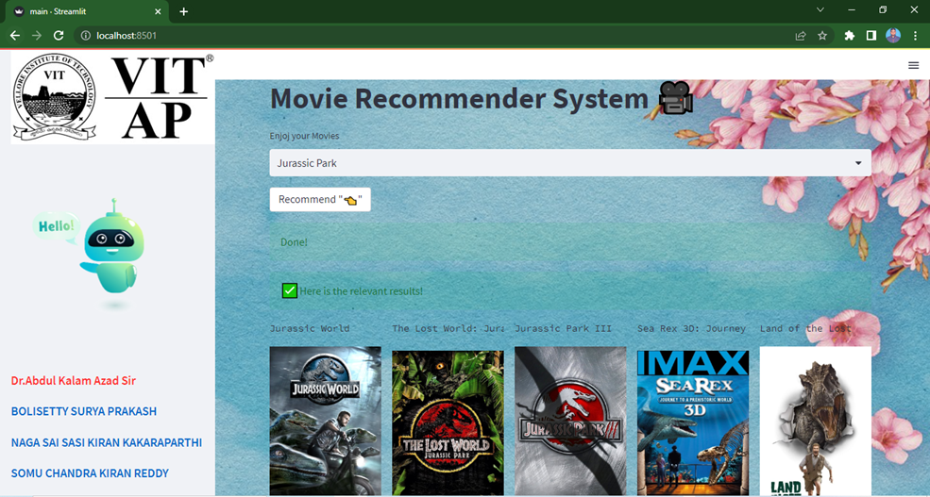
Front-End(Streamlit)
Results Screenshots:

Slide 29
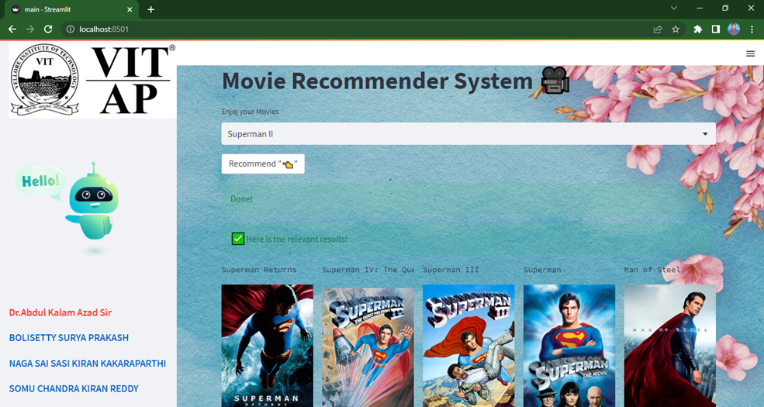

Slide 30
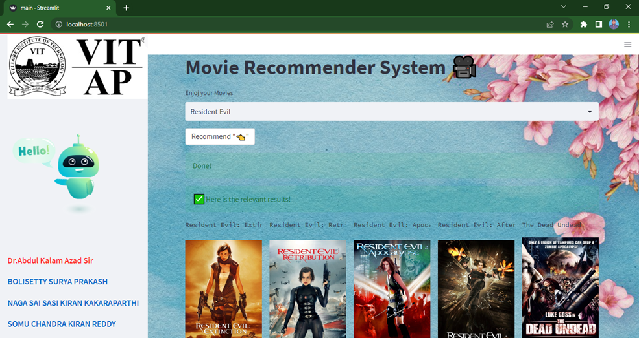

Slide 31
Discussion:
We can clearly observed that recommend function is working as intended, and is returning a list of movies that are similar to "Superman II."
The movies that are being returned are all part of the Superman film franchise, which makes sense since "Superman II" is also a part of this franchise.
Likewise , other films also , I have attached Resident Evil and Jurassic Park , the same mechanism applied through this search engines also like it will returning a list of movies that are similar to franchise and genre kind of movies.
In addition to content filtering, there are other approaches to building movie recommendation systems, such as collaborative filtering and hybrid approaches that combine elements of both content filtering and collaborative filtering.
These are the project source code files VITAP_MRS

Slide 32
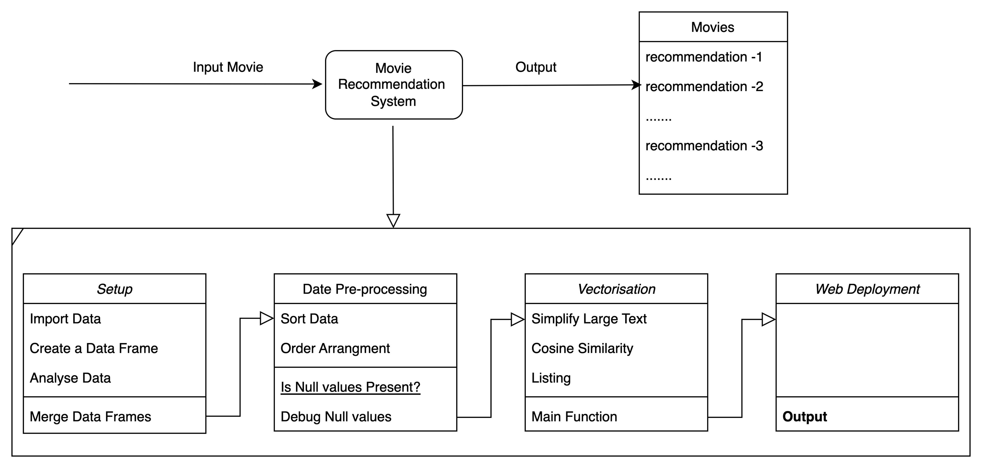
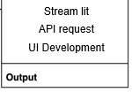
Architecture

Slide 33
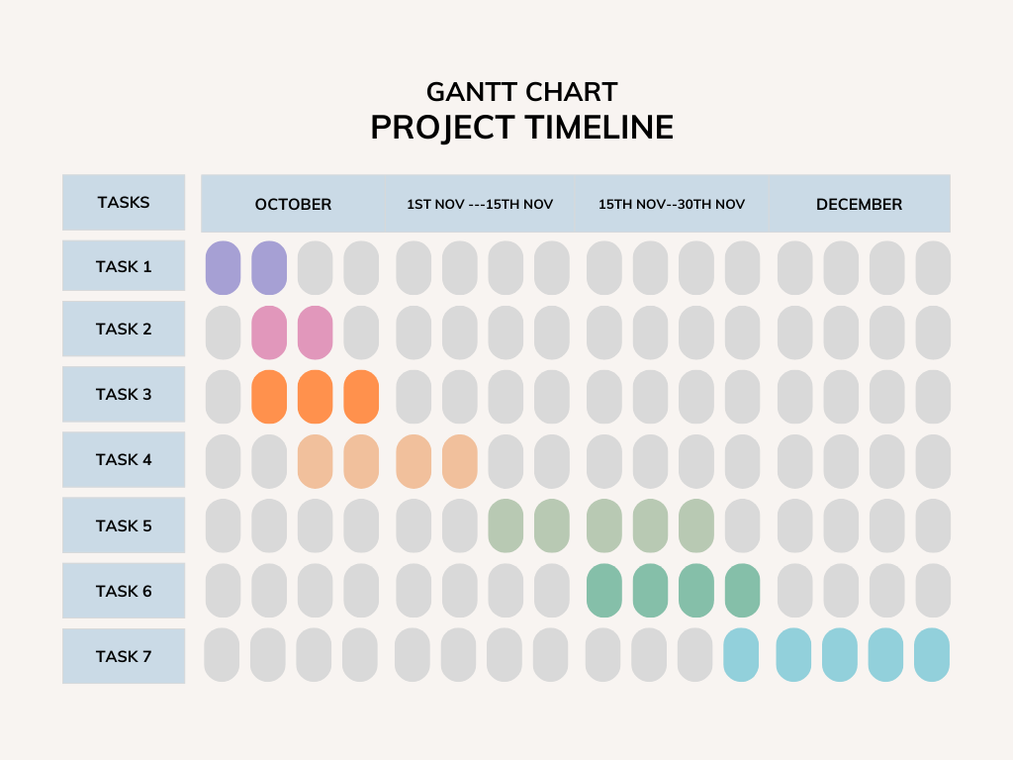
Gantt chart
Case study
Data collection
Data preprocessing
Vectorisation
Algorithm
UI
Development
Final
Deployment

Slide 34
Thank You

